Slide 1


How can AI impact
Austin Yu & Willson Leong
BUS 464 - D200
Notes:
Hey guys, with

Slide 2

Executive Summary
EdTech Overview
Use Cases
UC-1: AI Quiz Generation
UC 2- 5
ERD
Entity Relationship Diagram
SQL Database Construction
Database Datasources
Kaggle
ChatGPT
Queries
Managerial + SQL Queries
Notes:
Here’s a quick overview of today’s agenda.. I’ll give an
overview of quizlet,
a dive into our AI usecases and how it can benefit Quizlet
and we’ll also chat about how we constructed our database, and the queries with it too.

Slide 3
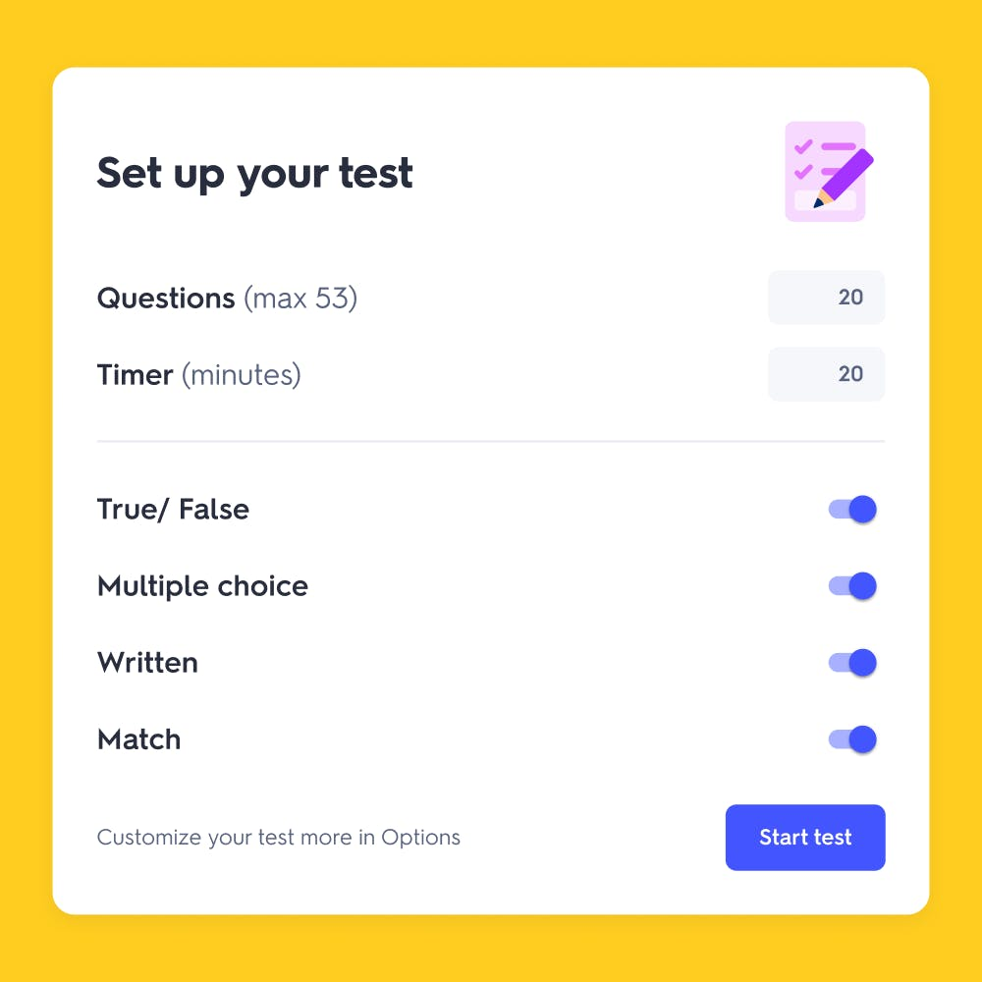
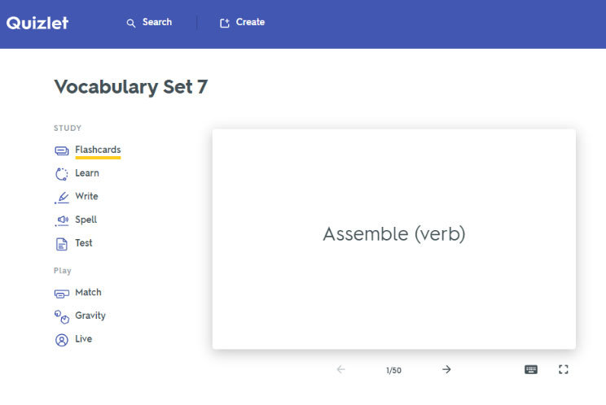
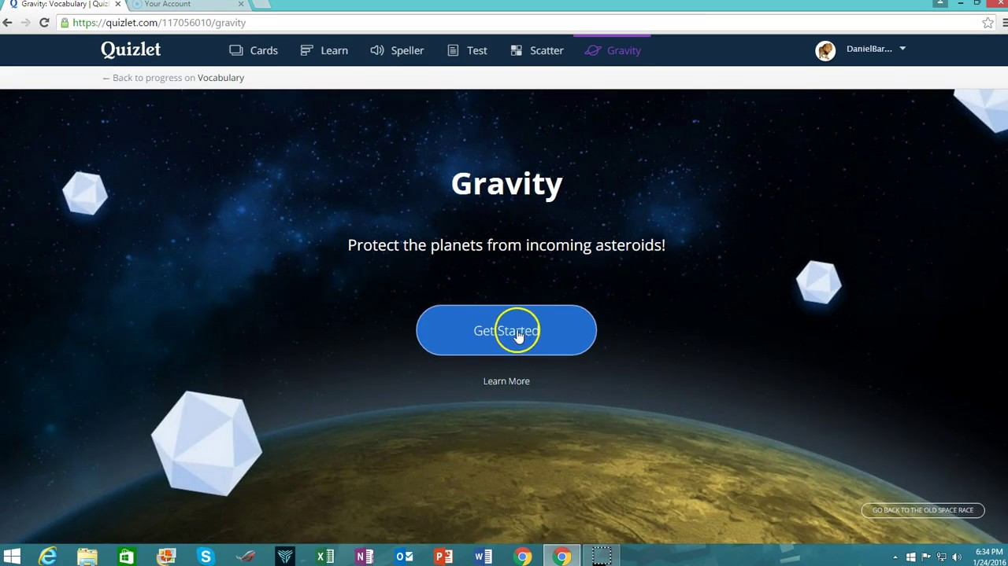
About Quizlet
Quizlet is an online learning platform that offers a variety of tools and resources to help students study and master various subjects. They are known for having:
Digital flashcards, allowing users to create sets of questions and answers to aid in memorization and review.
Interactive Games, games like "Match" and "Gravity" make the learning process more enjoyable.
Mock Tests, users can access a "Test" mode as one of the study options.
Notes:
So heres an overview of quizlet I’m sure you all know what quizlet is but as a refresher, the’re an online learning platform thatoffers resources to help students learn.here are their 3 main functions.
First one being Digital flashcards, allowing users to create sets of questions and answers to aid in memorization and review.
Interactive Games, games like "Match" and "Gravity" make the learning process more enjoyable
Mock Tests, users can access a "Test" mode as one of the study options.
Austin and I have both used quizlet a lot throughout our undergrad studies, and we wanted to see how AI could enhance one of these main features. We decided to see explore how AI could help Mock tests and quizes

Slide 4
About Quizlet
Quizlet is an online learning platform that offers a variety of tools and resources to help students study and master various subjects. They are known for having:
Digital flashcards, allowing users to create sets of questions and answers to aid in memorization and review.
Interactive Games, games like "Match" and "Gravity" make the learning process more enjoyable.
Mock Tests, users can access a "Test" mode as one of the study options.
Notes:
We decided to see explore how AI could help Mock tests and quizes

Slide 5

How can AI impact Quizlet?
Use Case | UC-1 AI Quiz Generation
User | Student
Pre-condition | - The student has an active Quizlet account. - Relevant study materials are available.
Post-condition | - The student receives a dynamically AI generated quiz. - Performance analytics are updated.
Main Scenario/Basic Path | The student logs into their Quizlet account. The AI system analyses the student's past quiz performances, study habits, and proficiency levels. The system’s AI algorithms dynamically generate a quiz by selecting questions from the available study materials. The difficulty level of questions is adjusted based on the student's historical performance. The system presents the quiz to the student, providing a mix of question types (e.g., multiple choice, true/false, short answer). The student answers the quiz questions. The system provides AI generated instant feedback on correctness and offers explanations for incorrect answers. The system updates the student's performance analytics, identifying strengths and weaknesses in specific topics or concepts. Based on the quiz results, the system may recommend additional study materials or direct the student to specific areas for improvement.
Other | The system ensures that questions are diverse, covering various aspects AI continuously adapts to the student's progress, refining the learning path
(UC-1) AI Quiz Generation
AI Generated quiz questions
Questions derived from material online, or previously uploaded
AI generated instant feedback/recommendations
AI detection
AI generated Quiz
AI generated Feedback
Notes:
Our first way of implementing AI into quizlet is automating their quiz generation:
First, it starts with The student logs into their Quizlet account
Next, the AI system analyses the student's past quiz performances, study habits, and proficiency levels and based on this, the system would generate questions based on
Students historical performance
Selected topic
And type of questions (mc/tf/sa
The student then answers the questions and the system will provide an AI generated feedback on the their answers
i’ve listed the steps on red there on the side, starting with detection, generation ,and feedback

Slide 6
Other Use-Cases
Use Case | Name | User | Result
UC-1 | AI Quiz Generation | Student | AI - generated quiz questions & Recommended Feedback
UC-2 | Student Performance Dashboard | Student | Student dashboard, with AI generated feedback
UC-3 | Flashcard Recommendation | Student | AI system generates a set of flashcards that specifically target the identified knowledge gaps.
UC-4 | Uploaded textbook ML | Student | The ML model processes the uploaded textbook, extracting key concepts, definitions, and questions.
UC-5 | Managerial KPI Dashboard | Manager | KPIs on how this AI implementations impacts users, AI recommendations on system performance, and user-usage
Notes:
Austin

Slide 7
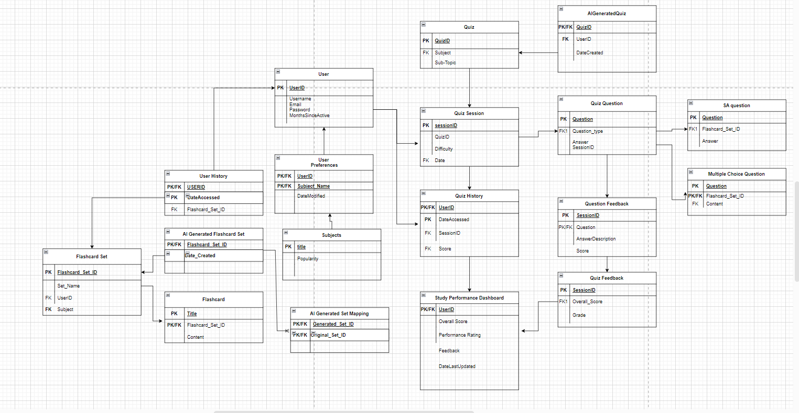
Entity Relationship Diagram (Picture of ERD)
Notes:
Austin

Slide 8

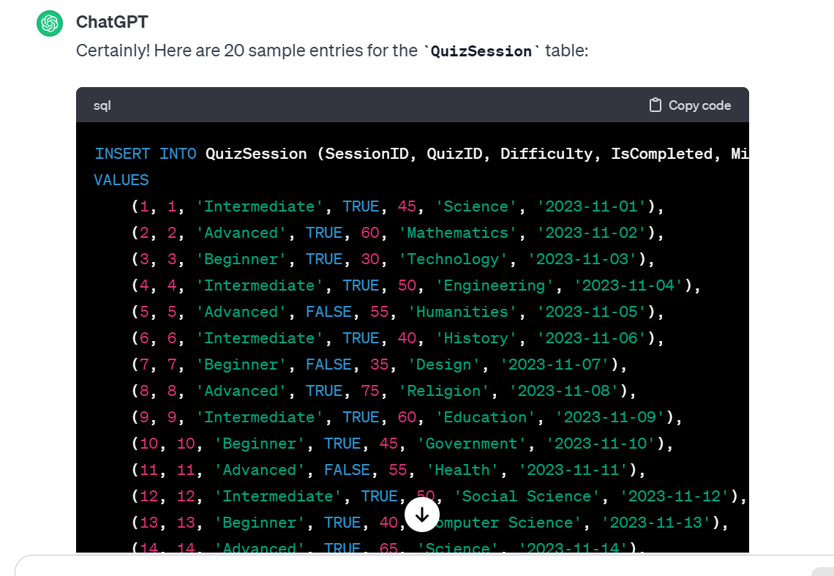
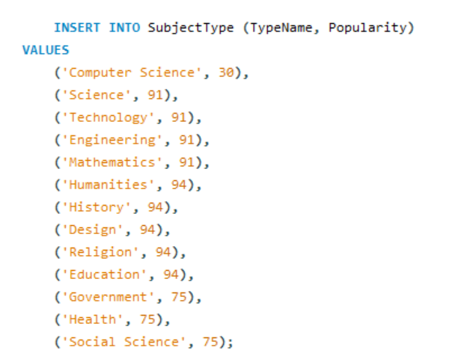

Data sources (Austin)
Notes:
Austin

Slide 9
How can AI impact Quizlet?
(UC-1) AI Quiz Generation Queries
Function | SQL QUERY
Check login info (Username:: Robert pass: password) | SELECT * FROM user WHERE Username == “Robert” AND password == “password”;
Retrieve the frequency of each flashcard set in each user’s flashcard access history | SELECT count(*) FROM FlashcardHistory GROUP BY UserID, Flashcard_Set_ID;
Retrieve most frequently taken quiz for a certain user (UserID = 9999) | SELECT q.QuizID FROM SessionID s JOIN Quiz q ON s.SessionID = q.SessionID WHERE s.UserID = “9999” ORDER BY count(q.QuizID) DESC LIMIT 1;
Retrieve the list of flashcards pertaining to the subject Law in the user’s flashcard access history (UserID = 9999) | SELECT * FROM FlashcardSet WHERE Subject = “Law AND CreatedBy = “9999”;
Choose the most popular flashcard set from user’s flashcard set history for informing quiz generation (UserID = 9999) | SELECT Flashcard_Set_ID FROM FlashcardHistory WHERE UserID = 9999 GROUP BY UserID, Flashcard_Set_ID ORDER BY count(Flashcard_Set_ID);
Notes:
aAustin

Slide 10
SQL Queries
UC-2: Student Performance Dashboard
Function | SQL QUERY
Retrieve list of quizzes each user has completed along with metrics like scores and time spent | SELECT qs.QuizID, qs.MinutesSpent, qf.Score, FROM QuizHistory qh JOIN QuizSession qs ON qh.SessionID = qs.SessionID JOIN QuizFeedback qf ON qs.SessionID = qf.SessionID WHERE qh.UserID = 9999 AND qs.IsCompleted = True;
Retrieve average quiz performance (score) of each user | SELECT Average(Score) FROM QuizFeedback GROUP BY UserID;
Retrieve average time spent on quizzes in each subject | SELECT Average(qs.MinutesSpent) FROM QuizSession qs JOIN SubjectType s ON qs.SubjectName = s.TypeName GROUP BY s.SubjectType
Notes:
Austin

Slide 11
SQL Queries
UC-3: Student Performance Dashboard
Function (Assume UserID = 9999) | SQL QUERY
Retrieves a user’s lowest scored quiz in their quiz history and provides list of flashcard sets with the same subject as the quiz | SELECT * FROM FlashcardSet WHERE SubjectName IN (SELECT qs.SubjectName as SubjectName FROM QuizFeedback qf JOIN QuizSession qs ON qf.QuizID = qf.QuizID WHERE UserID = 9999 ORDER BY Score DESC LIMIT 1);
Retrieves a user’s lowest scored quiz by average score in their quiz history and provides list of flashcard sets in the user’s flashcard access history with the same subject as the quiz | SELECT * FROM FlashcardHistory fh JOIN FlashcardSet fs ON fh.Flashcard_Set_ID = fs.Flashcard_Set_ID WHERE fs.SubjectName IN (SELECT qs.SubjectName as SubjectName FROM QuizFeedback qf JOIN QuizSession qs ON qf.QuizID = qf.QuizID WHERE UserID = 9999 ORDER BY Score DESC LIMIT 1);
Choose top 5 most popular subjects for informing ai flashcard set recommendation | SELECT * FROM SubjectType ORDER BY Popularity DESC LIMIT 5;
Notes:
Austin

Slide 12
Managerial SQL Queries
Function | MANAGERIAL SQL QUERY
User Engagement Query: Retrieve the number of active users in the last month | SELECT Count(*) FROM User WHERE MonthsSinceActive = 0;
Average AI Quiz Performance for students Retrieve the average AI-GENERATED quiz performance Can compared to non-ai quizzes | SELECT Average(qf.Score) FROM AIGeneratedQuiz ai JOIN QuizFeedback qf ON ai.QuizID = qf.QuizID;
AI - Flashcard Usage Query Retrieve the most commonly used flashcards | SELECT Flashcard_Set_ID, Count(*) as FlashcardUsageCount FROM FlashcardHistory GROUP BY Flashcard_Set_ID ORDER BY Count(*) DESC LIMIT 10;
AI-Generated Subject Popularity Query Retrieve the most commonly AI-generated subjects | SELECT s.TypeName FROM SubjectType s JOIN Quiz q ON s.TypeName = q.SubjectName JOIN AIGeneratedQuiz ai ON q.QuizID = ai.QuizID GROUP BY s.TypeName ORDER BY Count(*) DESC;
Time-of-Day Engagement Query: Retrieve the most popular times Optimise content delivery by identifying peak times of user engagement. | SELECT HourTime, Count(*) as numLogins FROM LoginTimes GROUP BY HourTime ORDER BY Count(*) DESC LIMIT 3;
Notes:
Willson

Slide 13
Managerial SQL Queries
Function | MANAGERIAL SQL QUERY
Average Time Spent on Platform Query Retrieve the average number of minutes spent on the platform Compare Before and after AI implementation | SELECT Average(MinutesSpent) FROM LoginTimes;
User Demographics Query Retrieve the count of users from different demographic | SELECT COUNT(UserID) FROM User GROUP BY AgeGroup;
AI-Quiz Session Completion Time Query | SELECT Average(qs.MinutesSpent) FROM AIGeneratedQuiz ai JOIN QuizSession qs ON ai.QuizID = qs.QuizID WHERE IsCompleted = True;
% of people who fill out AI quiz feedback Retrieve the % and count of users who fill out feedback forms | SELECT count(*) FROM QuizSession qs JOIN AIGeneratedQuiz ai ON qs.QuizID = ai.QuizID WHERE qs.isFeedback = true;
% of positive feedback versus negative feedback on AI featrures | SELECT Count(*)/(SELECT COUNT(*) FROM QuizFeedback) as ratio FROM QuizFeedback WHERE FeedbackType = “Positive”;
Notes:
Willson

Slide 14
Executive Summary
Company Selection
AI Use Cases
UC-1: AI Quiz Generation
UC 1- 4
ERD
ERD
Quizlet Database
Database Datasources
Kaggle
ChatGPT
Queries
Managerial + SQL Queries
Notes:
Willson

Slide 15
Use cases 2
Use Case No | UC-2
Name | Student Performance Dashboard
User | Student
Pre-condition | The student has an active Quizlet account. The student has participated in AI quizzes or assessments
Post-condition | The student gains insights into their own performance. Individual performance metrics are updated and visible in the student performance dashboard
Main Scenario/Basic Path | The student logs into their Quizlet account. The student navigates to the Student Performance Dashboard within their account. The system presents an overview of the student's performance, including aggregate scores, completion rates, and other relevant metrics. The dashboard displays a history of AI genereated quizzes or assessments the student has completed, indicating scores and time spent on each. The system highlights areas of strength and topics that may require improvement based on the student's performance in quizzes The system's AI algorithm provides study recommendations or links to additional resources tailored to the student's performance and identified areas of improvement. The student has the option to set personal learning goals directly from the dashboard, aligning with areas they wish to focus on or improve. The system provides positive feedback for achievements and recognizes progress, fostering a positive learning experience.
Other | The dashboard design is user-friendly, with a focus on providing actionable insights to enhance the student's learning journey.

Slide 16
Use cases 3
Use Case No | UC-3
Name | AI Generated Flashcard Recommendation
User | Student
Pre-condition | The student has an active Quizlet account. The student has engaged with previous study materials or quizzes.
Post-condition | The system recommends relevant flashcards to the student
Main Scenario/Basic Path | The Student logs into their Quizlet account. The system analyzes the Student's past study sessions, quiz performances, and flashcard interactions. Based on the analysis, the system identifies areas where the Student may have knowledge gaps or areas that need reinforcement. The AI system generates a set of flashcards that specifically target the identified knowledge gaps. The Student reviews and interacts with the recommended flashcards. As the Student engages with the flashcards, the system provides real-time feedback on their progress and understanding. The system updates the Student's study path, taking into account the newly acquired knowledge and adjusting future recommendations accordingly

Slide 17
Use cases 4
Use Case No | UC-4
Name | Uploaded textbook ML
User | Student
Pre-condition | The student has an active Quizlet account. The student possesses a digital textbook or study material for upload
Post-condition | The uploaded textbook is processed by the ML model. Relevant flashcards or study materials are generated based on the student-uploaded content. The student gains access to the newly generated study materials. The student's learning path is updated to incorporate the content from their uploaded textbook.
Main Scenario/Basic Path | The student logs into their Quizlet account. The student uploads a digital textbook or study material to the Quizlet platform. The ML model processes the uploaded textbook, extracting key concepts, definitions, and questions. Based on the ML processing, the system generates flashcards or study materials using the content provided by the student. The student gains access to the newly generated flashcards or study materials. The student engages with the new content, reviewing flashcards and studying the materials. The system provides real-time feedback on the student's interaction, gauging understanding and proficiency. The system updates the student's learning path is automatically updated to include the new content from their uploaded textbook

Slide 18
Use cases 5
Use Case No | UC-5
Name | Managerial KPI Dashboard
User | Quizlet Manager
Pre-condition | The manager/administrator has an active account and appropriate permissions on the system. Relevant Key Performance Indicators (KPIs) data is available in the system.
Post-condition | The manager gains a comprehensive view of organizational performance. Decision-making is informed by real-time and historical data presented in the KPI dashboard.
Main Scenario/Basic Path | The Manager/Administrator logs into the system using provided credentials. The Manager/Administrator navigates to the Managerial KPI Dashboard section within their account. The Manager/Administrator selects specific KPIs or customizes a set of metrics to monitor. The System displays real-time data for the selected KPIs, providing an immediate snapshot of the organization's performance. The Manager/Administrator analyzes historical data by toggling to view trends and patterns over time. The Manager/Administrator conducts comparative analysis by comparing current KPIs against benchmarks, goals, or historical averages. The Manager/Administrator applies filters and drills down into specific data points, departments, or projects for a more detailed analysis. The System provides an option for the Manager/Administrator to download comprehensive reports summarizing the KPI data for offline analysis or presentation purposes.
Other

Slide 19
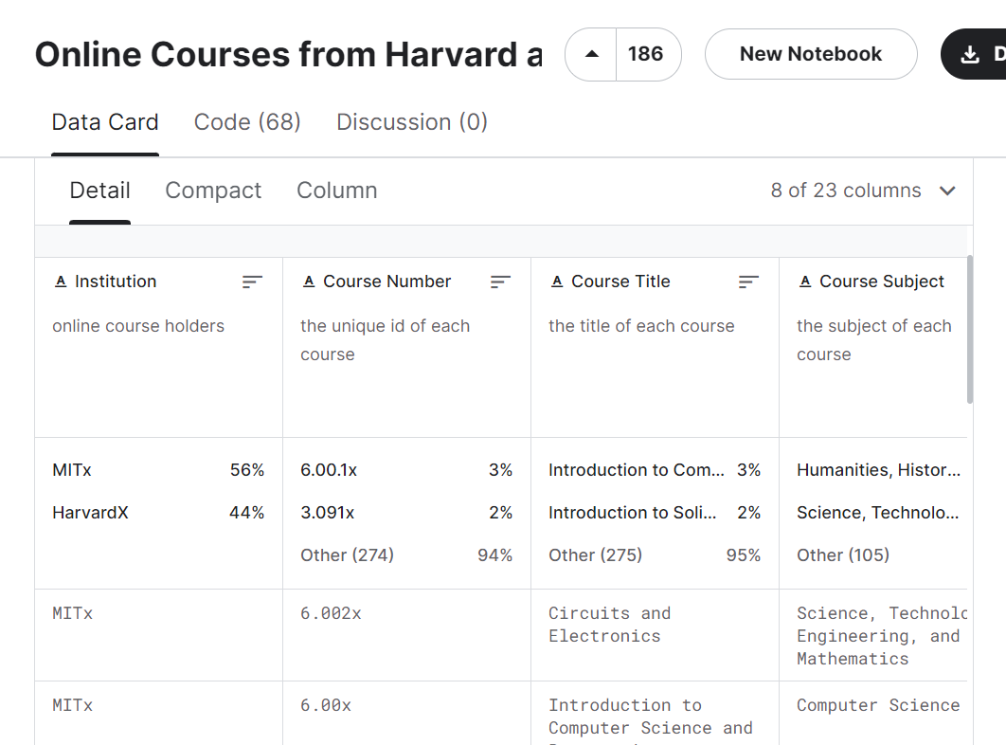

Slide 20
Risks & Challenges
Challenges in AI
For UC-1, The accuracy of the system's analysis of past quiz performances, study habits, and proficiency levels is essential and can be misinterpreted by AI. Ensuring the precision of these AI interpretations is crucial for tailoring the learning experience effectively.
Other challenges that Quizlet would face include maintaining adaptability to diverse learning styles, and safeguarding user privacy while implementing AI to enhance features like dynamic quiz generation and personalised learning paths.

